Slide 1






Satellite Data-Based Soil Texture Classification Using Random Forests Classifier
Student Details
Name: Rishi Ganesh L
NM Id: au2021107015
College Name: College of Engineering Guindy, Anna University, Chennai -25

Slide 2
Agriculture Raw Material Analysis
Disclaimer
The content is curated from online/offline resources and used for educational purpose only

Slide 3

Project Outline
Agriculture Raw Material Analysis
Abstract
Problem Statement
Proposed Solution
Data Collection, Preprocessing, EDA
Model Development & Algorithm
Future Scope
Video of the Project
Conclusion
Reference

Slide 4


Agriculture Raw Material Analysis
Abstract
Soil classification crucial for crop planning, fertilizer selection, and irrigation management.
Variety of soil types based on texture with unique properties.
Soil texture data collected from satellite imagery for Germany.
Utilization of Random Forest classifier for dataset classification on the basis of soil texture by soil composition.
Performance assessment of Random Forest classifier.
Comparison with other classifiers: Support Vector Machines and Decision Trees.

Slide 5


Agriculture Raw Material Analysis
Problem Statement
Farmers often face challenges in selecting suitable soil types for their crops.
Inaccurate soil information leads to wasteful resource usage like water, fertilizers, and pesticides.
Consequences include lower agricultural yields and increased environmental impact.
Poor soil management can result in erosion, nutrient depletion, and land quality degradation.

Slide 6

Agriculture Raw Material Analysis
Proposed Solution
Proposal: Develop a soil type classification system using machine learning.
Utilize soil data collected from remote sensing satellites.
Key variables include sand, silt, clay content, and moisture levels.
Aim to provide farmers with insights for crop selection, irrigation, and soil conservation.
Potential benefits: optimized resource allocation, increased crop yield, reduced environmental impact.
Overall goal: promote sustainable agriculture and improve rural livelihoods.

Slide 7
Agriculture Raw Material Analysis
Objectives
To classify the soil on the basis of USDA Taxonomy on Soil Texture using Random Forest Classifier.
To identify the potential features which would be helpful in determining the class of soil texture.
To compare the Random Forest classifier’s performance with Support Vector Machine and Decision Trees.
To visualize the datapoints as a map.

Slide 8
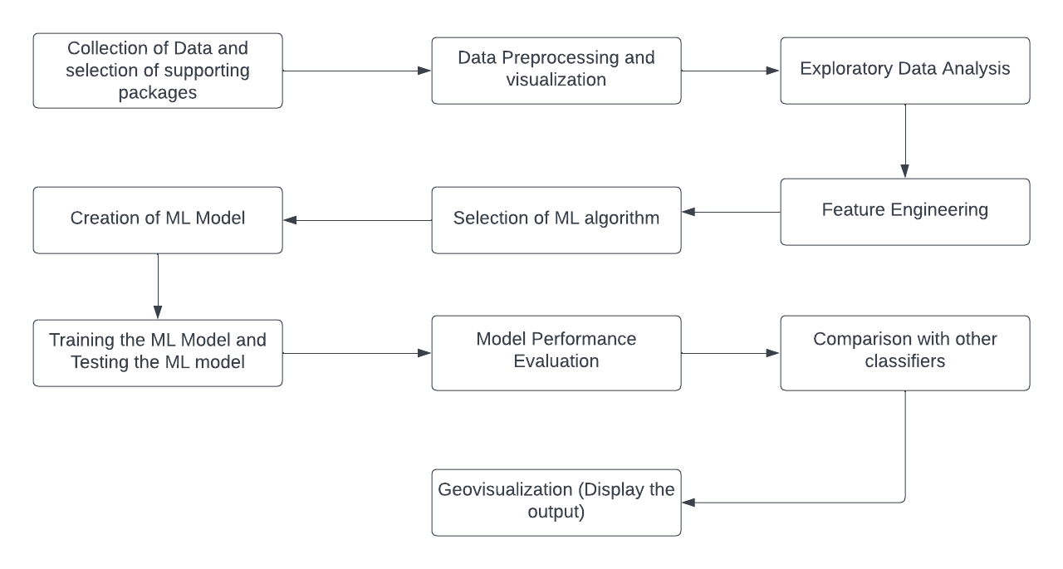
Agriculture Raw Material Analysis
Project Workflow
Full Code in - https://github.com/laksysrishi/soil_classification/blob/main/(IPYNB)au2021107015_RishiGaneshL_Naan_Mudhalvan_Project.ipynb
Notes:
8

Slide 9
Agriculture Raw Material Analysis
Model Development & Algorithm
Dataset Description:
The dataset contains remote sensing observations of soil characteristics.
Size of dataset is 321584 (321584 datapoints)
Features are: latitude, longitude, sm_aux, sm_tgt, sand_content, silt_content, clay_content
Location: Germany
Taken from Kaggle website
Dataset link - https://www.kaggle.com/code/sathyanarayanrao89/lstm-for-soil-moisture-prediction
Full Code in - https://github.com/laksysrishi/soil_classification/blob/main/(IPYNB)au2021107015_RishiGaneshL_Naan_Mudhalvan_Project.ipynb
Notes:
9

Slide 10
Agriculture Raw Material Analysis
Model Development & Algorithm
Data Overview:
The shape of the dataset is found by df.shape
The descriptive statistics is found by df.describe()
Using folium package in Python, the datapoints are visualized in Open Street Maps.
Data Preprocessing:
Upon visualization, it is found that few points are outside Germany. So using Germany shapefile, points outside Germany border are discarded.
Missing values are removed.
Duplicate values are removed.
Full Code in - https://github.com/laksysrishi/soil_classification/blob/main/(IPYNB)au2021107015_RishiGaneshL_Naan_Mudhalvan_Project.ipynb
Notes:
10

Slide 11
Agriculture Raw Material Analysis
Model Development & Algorithm
Feature Engineering:
‘time’ feature is removed as no temporal analysis would be performed by our objective.
Two satellites’ soil moisture values are averaged and appended in a new column.
Outliers Handling:
Using z-scores method, presence of outliers has been found.
Outliers are removed from the dataset.
Data Transformation:
Using min-max method, features (sand_content, silt_content, clay_content, sm_aux, sm_tgt, sm_avg) are normalized.
Full Code in - https://github.com/laksysrishi/soil_classification/blob/main/(IPYNB)au2021107015_RishiGaneshL_Naan_Mudhalvan_Project.ipynb
Notes:
11

Slide 12
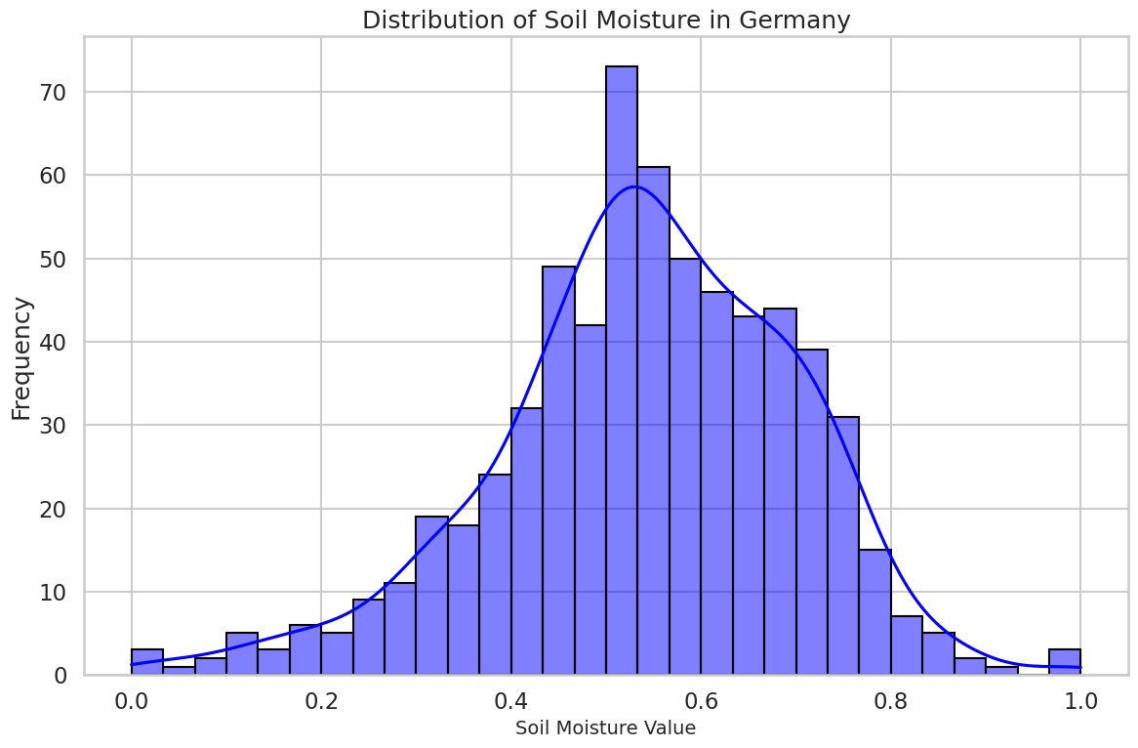
Agriculture Raw Material Analysis
Model Development & Algorithm
Exploratory Data Analysis:
Using df.corr() function, correlation matrix can be generated.
The distribution of soil moisture is estimated by the histogram distribution.
Syntax:
sns.histplot(df_normalized['sm_avg'], bins=30, kde=True, color='blue', edgecolor='black')
A significant portion of the land, specifically more than 50%, the soil moisture values are below 40%.
Full Code in - https://github.com/laksysrishi/soil_classification/blob/main/(IPYNB)au2021107015_RishiGaneshL_Naan_Mudhalvan_Project.ipynb
Notes:
12

Slide 13
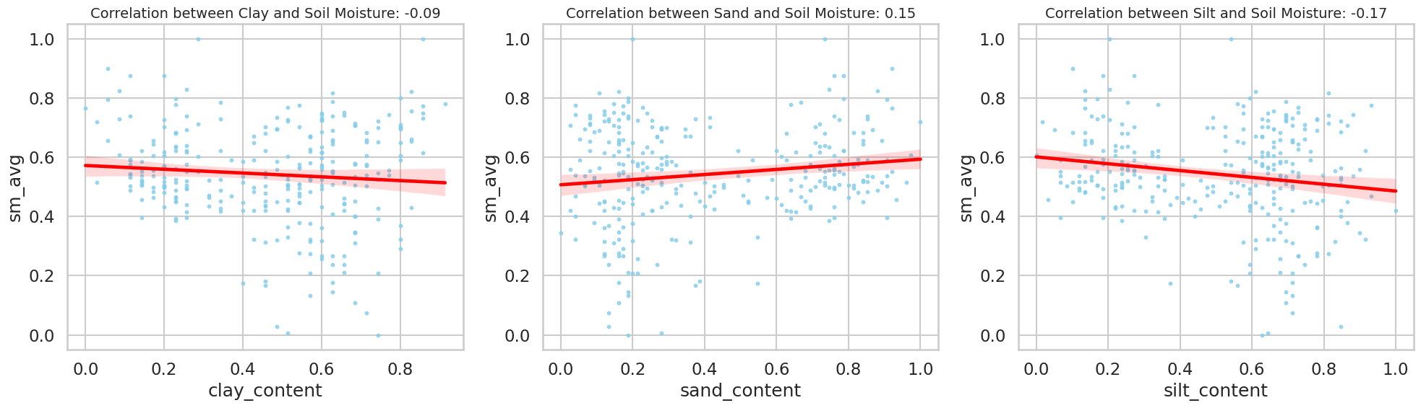
Agriculture Raw Material Analysis
Model Development & Algorithm
Exploratory Data Analysis:
There are no clear correlations between soil moisture content and composition, according to the correlation plots.
The absence of a distinct trend may indicate the influence of artificial irrigation.
Full Code in - https://github.com/laksysrishi/soil_classification/blob/main/(IPYNB)au2021107015_RishiGaneshL_Naan_Mudhalvan_Project.ipynb
Notes:
13

Slide 14
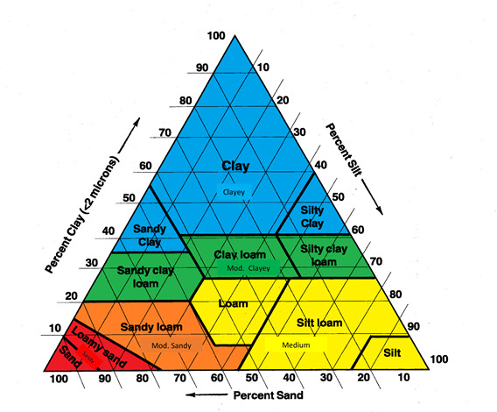
Agriculture Raw Material Analysis
Model Development & Algorithm
Feature Engineering – Adding the target variable:
Based on the conditions provided by USDA classification of soil texture, soil texture attribute is added to the dataset.
Feature Selection:
Soil moisture
Silt content
Clay content
Average soil moisture
are considered for classifying the dataset with ML Algorithm.
Full Code in - https://github.com/laksysrishi/soil_classification/blob/main/(IPYNB)au2021107015_RishiGaneshL_Naan_Mudhalvan_Project.ipynb
Notes:
14

Slide 15
Agriculture Raw Material Analysis
Model Development & Algorithm
Selection of ML Model – Random Forests:
Working:
The algorithm generates numerous decision trees during training.
Each tree contributes to the final prediction by voting for the most common class.
Random Selection of Features and Data:
For each decision tree, a random subset of features and training data is selected.
This randomness introduces diversity among the trees, reducing the risk of overfitting.
Full Code in - https://github.com/laksysrishi/soil_classification/blob/main/(IPYNB)au2021107015_RishiGaneshL_Naan_Mudhalvan_Project.ipynb
Notes:
15

Slide 16
Agriculture Raw Material Analysis
Model Development & Algorithm
Selection of ML Model – Random Forests:
Mode of Categorization Classes:
The final prediction is determined by the class that appears most frequently among the predictions of all decision trees.
This ensemble approach improves the overall accuracy and robustness of the model.
Contributes to the final prediction by voting for the most common class.
Random Selection of Features and Data:
For each decision tree, a random subset of features and training data is selected.
This randomness introduces diversity among the trees, reducing the risk of overfitting.
Full Code in - https://github.com/laksysrishi/soil_classification/blob/main/(IPYNB)au2021107015_RishiGaneshL_Naan_Mudhalvan_Project.ipynb
Notes:
16

Slide 17
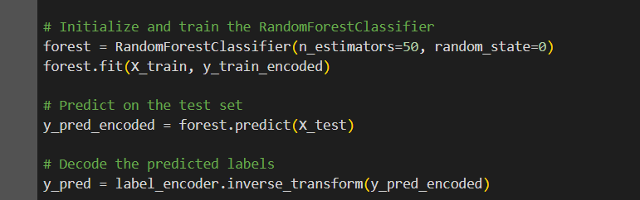
Agriculture Raw Material Analysis
Model Development & Algorithm
Creation and Training of ML Model
Using scikit learn library, test data and training data are split from the dataset.
Random forest model is initiated and the labels are encoded to supply into the model as input.
The model is trained by the input data.
Testing of ML Model
The model is also tested by the test data.
Full Code in - https://github.com/laksysrishi/soil_classification/blob/main/(IPYNB)au2021107015_RishiGaneshL_Naan_Mudhalvan_Project.ipynb
Notes:
17

Slide 18
Agriculture Raw Material Analysis
Model Development & Algorithm
Model Evaluation:
Overall Accuracy 1.000
Confusion Matrix:
[[ 2 0 0]
[ 0 25 0]
[ 0 0 128]]
Classification Report:
precision recall f1-score support
clay 1.00 1.00 1.00 2
sand 1.00 1.00 1.00 25
sandy clay 1.00 1.00 1.00 128
accuracy 1.00 155
macro avg 1.00 1.00 1.00 155
weighted avg 1.00 1.00 1.00 155
Full Code in - https://github.com/laksysrishi/soil_classification/blob/main/(IPYNB)au2021107015_RishiGaneshL_Naan_Mudhalvan_Project.ipynb
Notes:
18

Slide 19
Agriculture Raw Material Analysis
Model Development & Algorithm
Model Performance Comparison - SVM:
Accuracy: 0.987
Confusion Matrix:
[[ 0 0 2]
[ 0 25 0]
[ 0 0 128]]
Classification Report:
precision recall f1-score support
clay 0.00 0.00 0.00 2
sand 1.00 1.00 1.00 25
sandy clay 0.98 1.00 0.99 128
accuracy 0.99 155
macro avg 0.66 0.67 0.66 155
weighted avg 0.97 0.99 0.98 155
Full Code in - https://github.com/laksysrishi/soil_classification/blob/main/(IPYNB)au2021107015_RishiGaneshL_Naan_Mudhalvan_Project.ipynb
Notes:
19

Slide 20
Agriculture Raw Material Analysis
Model Development & Algorithm
Model Performance Comparison – Decision Trees:
Accuracy on the training subset: 0.993
Confusion Matrix:
[[ 1 0 0 1]
[ 0 25 0 0]
[ 0 0 128 0]
[ 0 0 0 0]]
Classification Report:
precision recall f1-score support
clay 1.00 0.50 0.67 2
sand 1.00 1.00 1.00 25
sandy clay 1.00 1.00 1.00 128
silty clay 0.00 0.00 0.00 0
accuracy 0.99 155
macro avg 0.75 0.62 0.67 155
weighted avg 1.00 0.99 1.00 155
Full Code in - https://github.com/laksysrishi/soil_classification/blob/main/(IPYNB)au2021107015_RishiGaneshL_Naan_Mudhalvan_Project.ipynb
Notes:
20

Slide 21
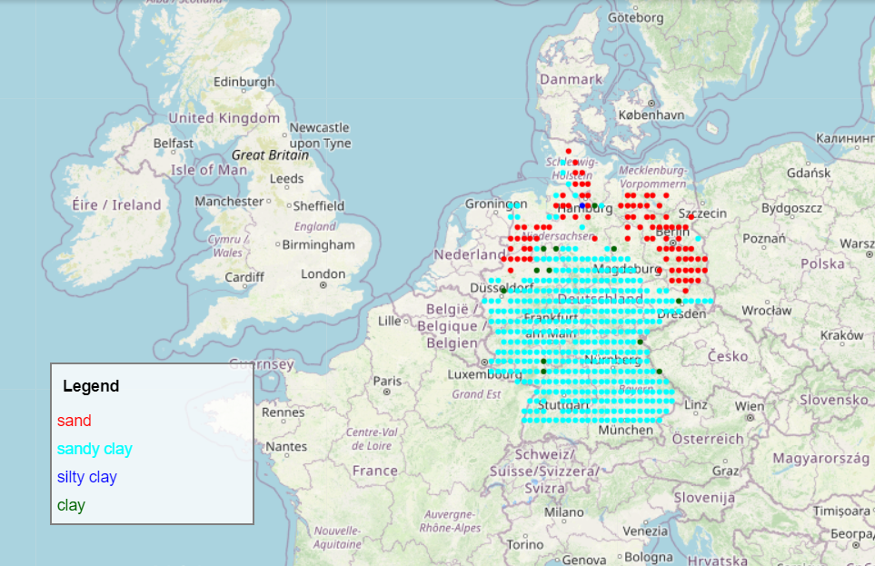
Agriculture Raw Material Analysis
Model Development & Algorithm
Geovisualization:
Full Code in - https://github.com/laksysrishi/soil_classification/blob/main/(IPYNB)au2021107015_RishiGaneshL_Naan_Mudhalvan_Project.ipynb
Notes:
21

Slide 22

Agriculture Raw Material Analysis
Future Scope
Utilize interpolation techniques like Kriging for estimating and visually mapping soil types across Germany.
Conduct temporal analysis of soil moisture using Long Short Term Memory (LSTM) Neural Networks.
Compare soil moisture data from two satellites to assess consistency and identify outliers.
Investigate outliers to understand their occurrence and potential implications.
Collect training sites from the field to enhance the accuracy of the algorithm.
Full Code in - https://github.com/laksysrishi/soil_classification/blob/main/(IPYNB)au2021107015_RishiGaneshL_Naan_Mudhalvan_Project.ipynb
Notes:
22

Slide 23
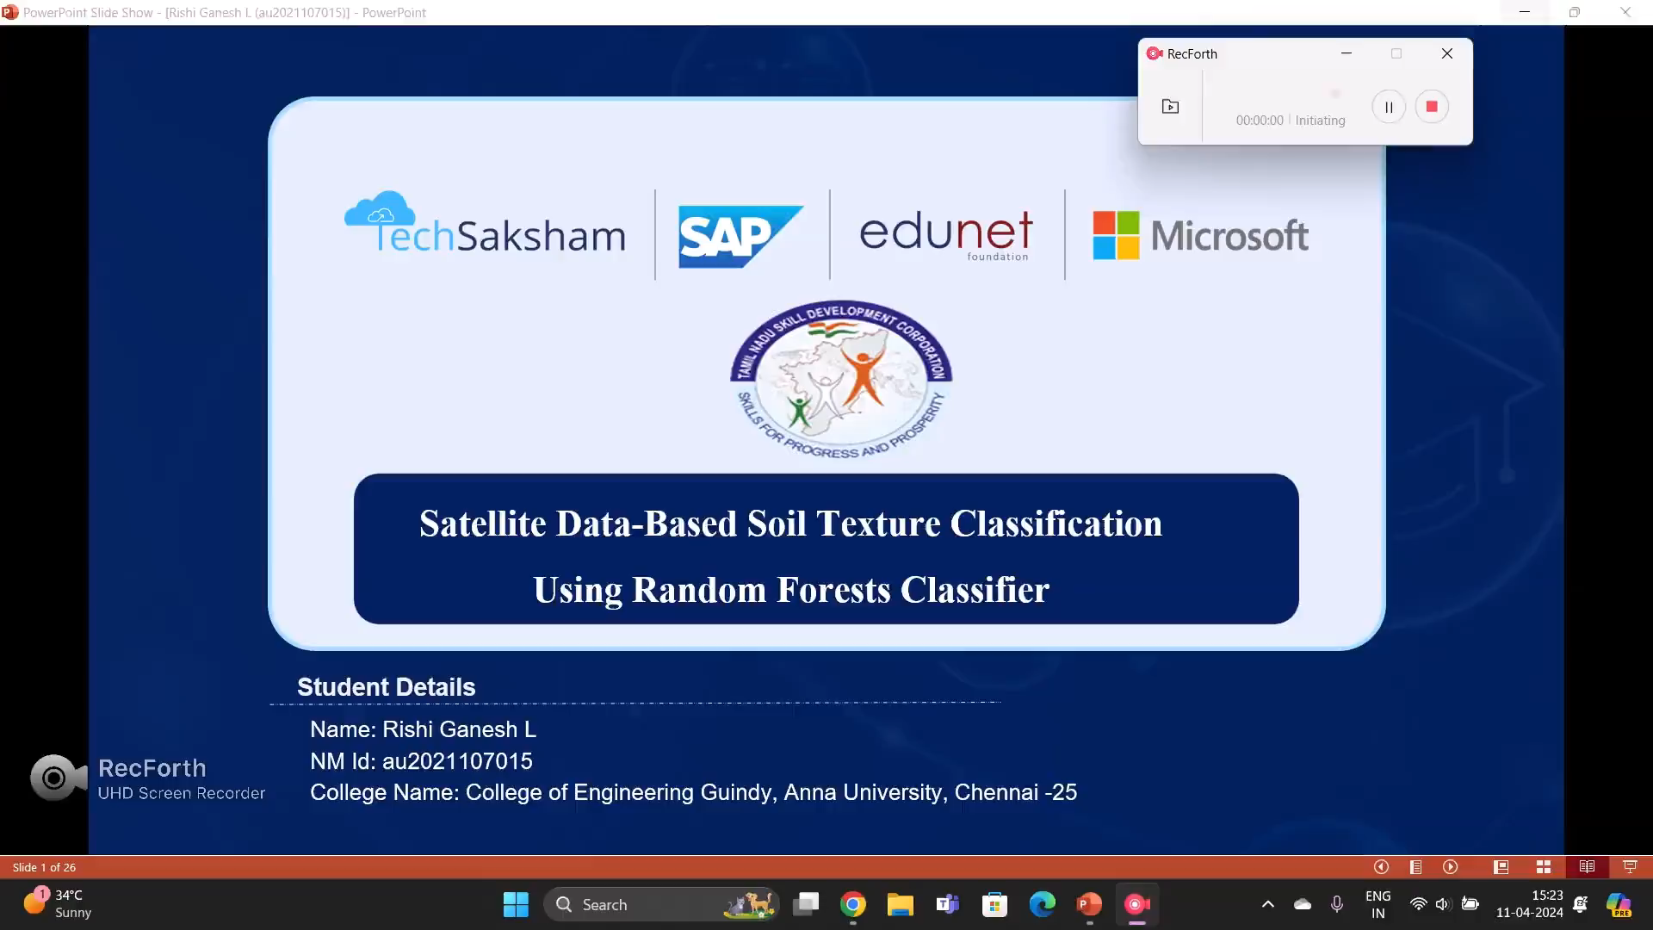
Agriculture Raw Material Analysis
Video of the Project
Full Code in - https://github.com/laksysrishi/soil_classification/blob/main/(IPYNB)au2021107015_RishiGaneshL_Naan_Mudhalvan_Project.ipynb
Notes:
23

Slide 24

Agriculture Raw Material Analysis
Conclusion
Random Forest Classifier achieved 100% accuracy in classifying soil based on composition (clay, sand, and silt), outperforming Support Vector Machine (98.7%) and Decision Tree Classifier (99.3%).
Soil composition appears to be independent of soil moisture, suggesting potential benefits from irrigation techniques.
ML classifier aids in assessing unpredictable conditions and determining feature importance.
OpenStreetMap utilized for visualizing points and filtering inner boundary points effectively.
Classification results displayed in OpenStreetMap; HTML file used for legend display.
Dominant soil type in Germany identified as sandy clay based on classification results.
Full Code in - https://github.com/laksysrishi/soil_classification/blob/main/(IPYNB)au2021107015_RishiGaneshL_Naan_Mudhalvan_Project.ipynb
Notes:
24

Slide 25
Agriculture Raw Material Analysis
Reference
Daniel R. Gambill, Wade A. Wall, Andrew J. Fulton, Heidi R. Howard,
‘Predicting USCS soil classification from soil property variables using Random Forest’, Journal of Terramechanics, Volume 65,2016, Pages 85-92, ISSN 0022-4898.
https://www.kaggle.com/code/sathyanarayanrao89/lstm-for-soil-moisture-prediction
Github Code Link:
https://github.com/laksysrishi/soil_classification/blob/main/(IPYNB)au2021107015_RishiGaneshL_Naan_Mudhalvan_Project.ipynb
Full Code in - https://github.com/laksysrishi/soil_classification/blob/main/(IPYNB)au2021107015_RishiGaneshL_Naan_Mudhalvan_Project.ipynb

Slide 26
Agriculture Raw Material Analysis
Thank you!
Notes:
26

